Slide 1
UPPER SIXTH ARTS
GEOGRAPHY
Lesson 7
Population Pyramids
Notes:
Good morning, class, and welcome to our geography lesson. I am your geography teacher, Mr Kamdem. Today we are starting Lesson 7: Population Pyramids.

Slide 2
CLASS INFO
Class, Chapter and Duration
Class | Upper Sixth Arts
Chapter | Module 4: Understanding and managing population dynamics across the world in general and Cameroon in particular
Duration | 2 periods (2 × 50 minutes)
Notes:
This lesson is for Upper Sixth Arts. It belongs to Module 4: Understanding and managing population dynamics across the world in general and Cameroon in particular. We shall need 2 periods to cover it.

Slide 3
IDENTIFICATION
Lesson Identification
Topic | Population Structure and Composition
Sub-topic | Age-Sex Pyramids
Lesson | Lesson 7: Population Pyramids
Notions / Concepts | Population pyramid, age cohort, base, apex, progressive, regressive, stationary and composite pyramids, dependency ratio.
Syllabus focus | Meaning, structure and types of population pyramids; differences between regions; demographic and non-demographic factors of their shape; dependency indices.
Competence | Learners are able to read and interpret population pyramids and explain the factors of their shapes.
Notes:
Our topic is Population Structure and Composition, and the sub-topic is Age-Sex Pyramids. The key notions we shall use today are: population pyramid, age cohort, base, apex, progressive, regressive, stationary and composite pyramids, dependency ratio. At the end, you should be able to do this: learners are able to read and interpret population pyramids and explain the factors of their shapes.

Slide 4

HOMEWORK CORRECTION
Correction of the Homework
Question (Lesson 6: Age and Sex Composition):
State what the base of a population pyramid represents.
Notes:
Before we start the new lesson, let us correct the homework I gave you at the end of Lesson 6: Age and Sex Composition. The question was: State what the base of a population pyramid represents. Take out your exercise books.

Slide 5
HOMEWORK CORRECTION
Correction: Possible Answer
The base represents the youngest age groups, so it shows the birth rate.
Notes:
Here is a good answer. The base represents the youngest age groups, so it shows the birth rate. Compare it with your own answer and correct your work in red.

Slide 6
LESSON PLAN
Lesson Plan
Correction of the homework
Objectives and recall
Real-life situation and action to take
Learning activities
Board summary
Evaluation, remediation and homework
Notes:
Here is the plan of our lesson today. First, we shall correct the homework. Then we shall look at the objectives and recall what you already know. After that, we shall study a situation from real life and the action to take, and do the learning activities. Finally, we shall copy the board summary, do the evaluation and the remediation, and I will give you the homework.

Slide 7
OBJECTIVES
Objectives
By the end of this lesson, you should be able to:
Define a population pyramid and describe its structure.
Describe the four types of population pyramids.
Notes:
Take your time to copy this part; we will continue together.

Slide 8
OBJECTIVES
Objectives (continued)
Compare the pyramids of developing, developed and emerging countries.
Explain the demographic and non-demographic factors of their shape.
Name the indices of dependency.
Notes:
By the end of this lesson, you should be able to do five things. Number 1: define a population pyramid and describe its structure. Number 2: describe the four types of population pyramids. Number 3: compare the pyramids of developing, developed and emerging countries. Number 4: explain the demographic and non-demographic factors of their shape. Number 5: name the indices of dependency.

Slide 9
PREVIOUS KNOWLEDGE
Previous Knowledge
About 42 % of Cameroonians are under 15.
Japan has an ageing population.
The sex ratio compares males and females.
Notes:
Let us first remember what you already know. About 42 % of Cameroonians are under 15. Japan has an ageing population. The sex ratio compares males and females. Keep this in mind, because we shall build on it today.

Slide 10
REAL-LIFE SITUATION
Situation in Real Life
On a Saturday morning at the Central Market of Garoua, you see hundreds of children helping their parents, selling water or running errands, and many young adults working as shop assistants and moto-taxi drivers.
You see very few people over 70 years.
Notes:
Take your time to copy this part; we will continue together.

Slide 11
REAL-LIFE SITUATION
Situation in Real Life (continued)
Your teacher says that all this can be shown on one graph shaped like a pyramid.
You ask: "How is this graph built, what shapes can it take, and what makes its shape change?"
Notes:
Listen carefully to this situation from real life. On a Saturday morning at the Central Market of Garoua, you see hundreds of children helping their parents, selling water or running errands, and many young adults working as shop assistants and moto-taxi drivers. You see very few people over 70 years. Your teacher says that all this can be shown on one graph shaped like a pyramid. You ask: "How is this graph built, what shapes can it take, and what makes its shape change?" Think about it, because I am going to ask you some questions.

Slide 12
REAL-LIFE SITUATION
Situation: Question 1
What is the problem in the situation?
Notes:
Question 1: What is the problem in the situation? Think for a moment, then raise your hand to answer.

Slide 13
REAL-LIFE SITUATION
Answer
The learner does not know how a population pyramid is built and interpreted.
Notes:
Good. The learner does not know how a population pyramid is built and interpreted.

Slide 14
REAL-LIFE SITUATION
Situation: Question 2
Which age group seems the largest in Garoua?
Notes:
Question 2: Which age group seems the largest in Garoua? Think for a moment, then raise your hand to answer.

Slide 15
REAL-LIFE SITUATION
Answer
The young (children and teenagers).
Notes:
Good. The young (children and teenagers).

Slide 16
REAL-LIFE SITUATION
Situation: Question 3
What problem does this cause for working adults?
Notes:
Question 3: What problem does this cause for working adults? Think for a moment, then raise your hand to answer.

Slide 17
REAL-LIFE SITUATION
Possible Answer
A heavy dependency burden: they must support many children.
Notes:
Good. A heavy dependency burden: they must support many children.

Slide 18
ACTION TO TAKE
Action to Take
Read a population pyramid from the base to the apex and explain every bulge or notch.
Notes:
From this situation, the action we are working towards in this lesson is the following: read a population pyramid from the base to the apex and explain every bulge or notch.

Slide 19
JUSTIFICATION
Justification of the Lesson
This lesson helps us to read population pyramids, which are used in examinations, in planning and in the study of development.
Notes:
Why is this lesson important for you? This lesson helps us to read population pyramids, which are used in examinations, in planning and in the study of development.

Slide 20
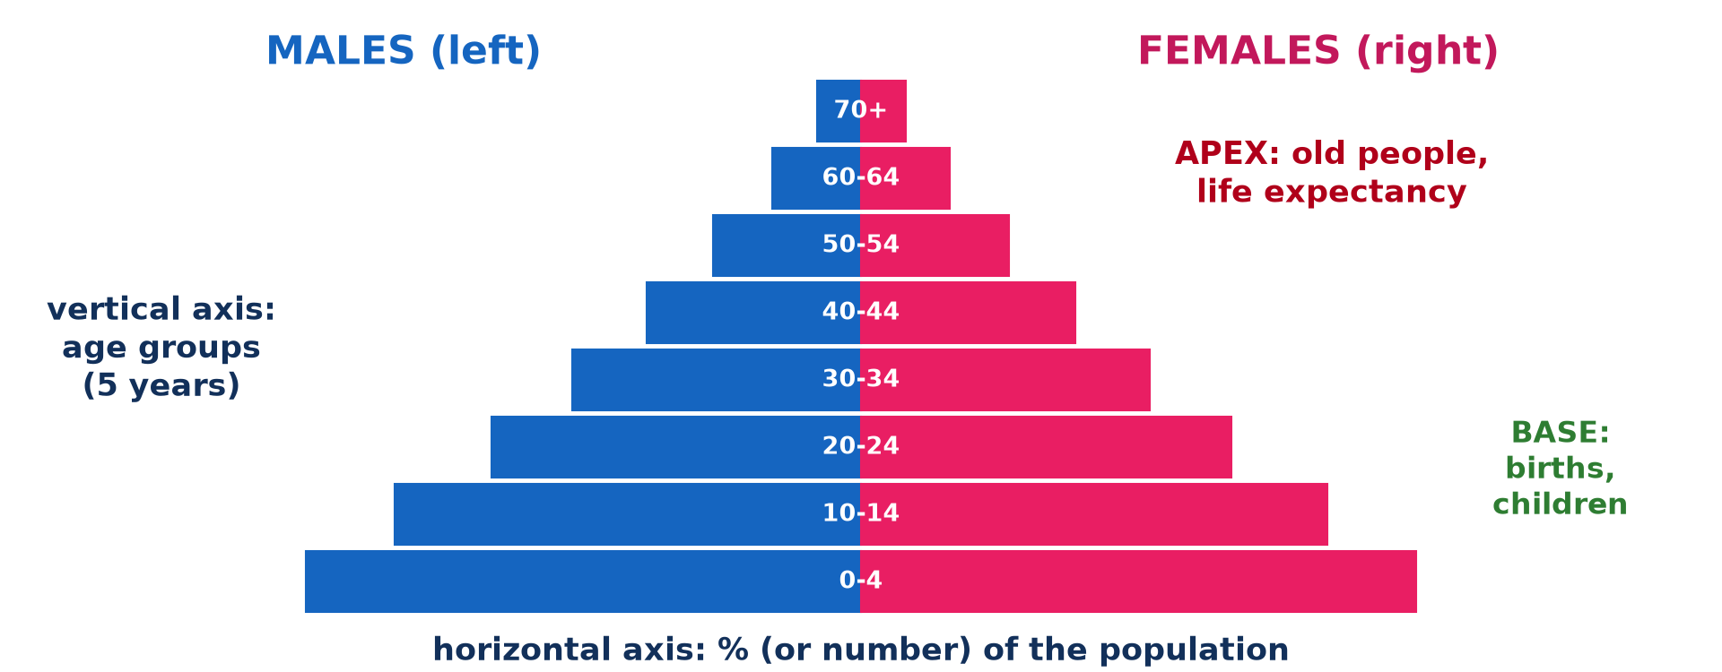
1. STRUCTURE
Activity 1
The parts of a pyramid.
Notes:
Activity 1. Look carefully at this picture: the parts of a pyramid. Observe every detail before I ask the question.

Slide 21
1. STRUCTURE
Activity 1: Question
On which side of the pyramid are the males?
Notes:
Here is the question for Activity 1: On which side of the pyramid are the males? Take one minute to think and write your answer in your rough notebook.

Slide 22
1. STRUCTURE
Activity 1: Answer
On the left.
Notes:
Let us check the answer together. On the left.

Slide 23
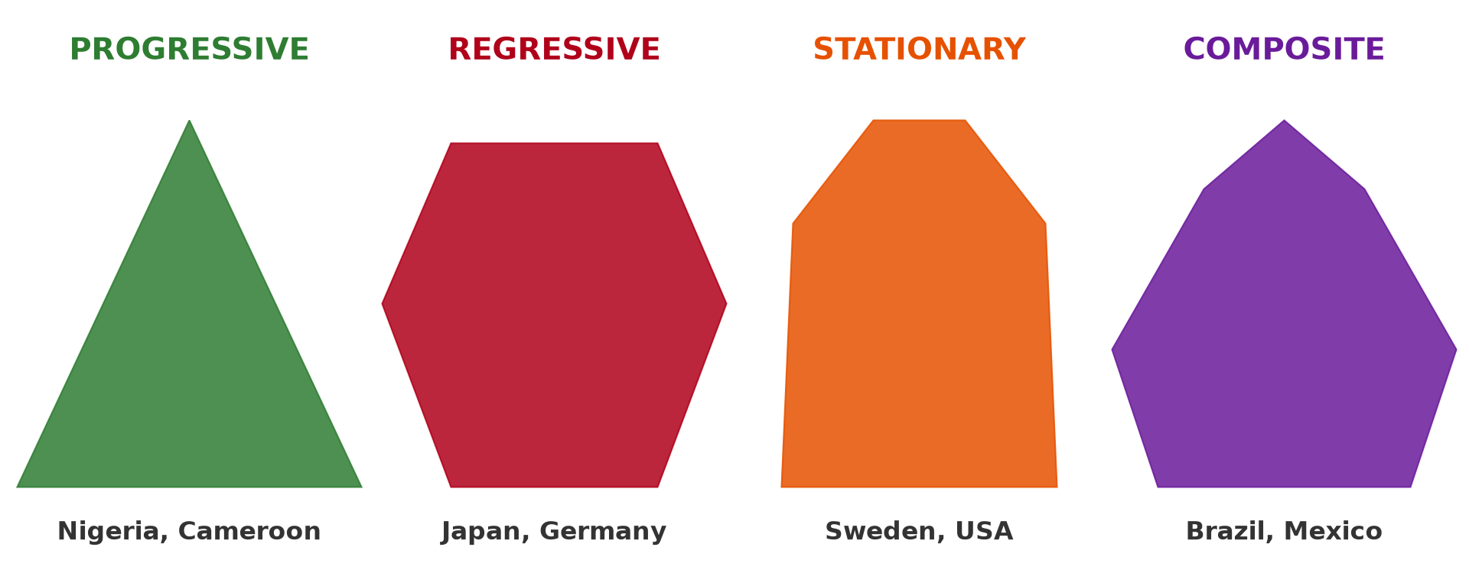
1. TYPES
Activity 2
Four types of pyramids.
Notes:
Activity 2. Look carefully at this picture: four types of pyramids. Observe every detail before I ask the question.

Slide 24
1. TYPES
Activity 2: Question
Which type of pyramid has a broad base and a narrow top?
Notes:
Here is the question for Activity 2: Which type of pyramid has a broad base and a narrow top? Take one minute to think and write your answer in your rough notebook.

Slide 25
1. TYPES
Activity 2: Answer
The progressive (expanding) pyramid.
Notes:
Let us check the answer together. The progressive (expanding) pyramid.

Slide 26

2. REGIONAL DIFFERENCES
Activity 3
The pyramid of Cameroon.
Notes:
Activity 3. Look carefully at this diagram: the pyramid of Cameroon. Observe every detail before I ask the question.

Slide 27
2. REGIONAL DIFFERENCES
Activity 3: Question
What type is the pyramid of Cameroon?
Notes:
Here is the question for Activity 3: What type is the pyramid of Cameroon? Take one minute to think and write your answer in your rough notebook.

Slide 28
2. REGIONAL DIFFERENCES
Activity 3: Answer
Progressive (expanding): broad base, narrow top.
Notes:
Let us check the answer together. Progressive (expanding): broad base, narrow top.

Slide 29

3. FACTORS
Activity 4
People fleeing a war.
Notes:
Activity 4. Look carefully at this picture: people fleeing a war. Observe every detail before I ask the question.

Slide 30
3. FACTORS
Activity 4: Question
How does a war change the shape of a pyramid?
Notes:
Here is the question for Activity 4: How does a war change the shape of a pyramid? Take one minute to think and write your answer in your rough notebook.

Slide 31
3. FACTORS
Activity 4: Answer
It makes notches, especially among adult men, and lowers births.
Notes:
Let us check the answer together. It makes notches, especially among adult men, and lowers births.

Slide 32
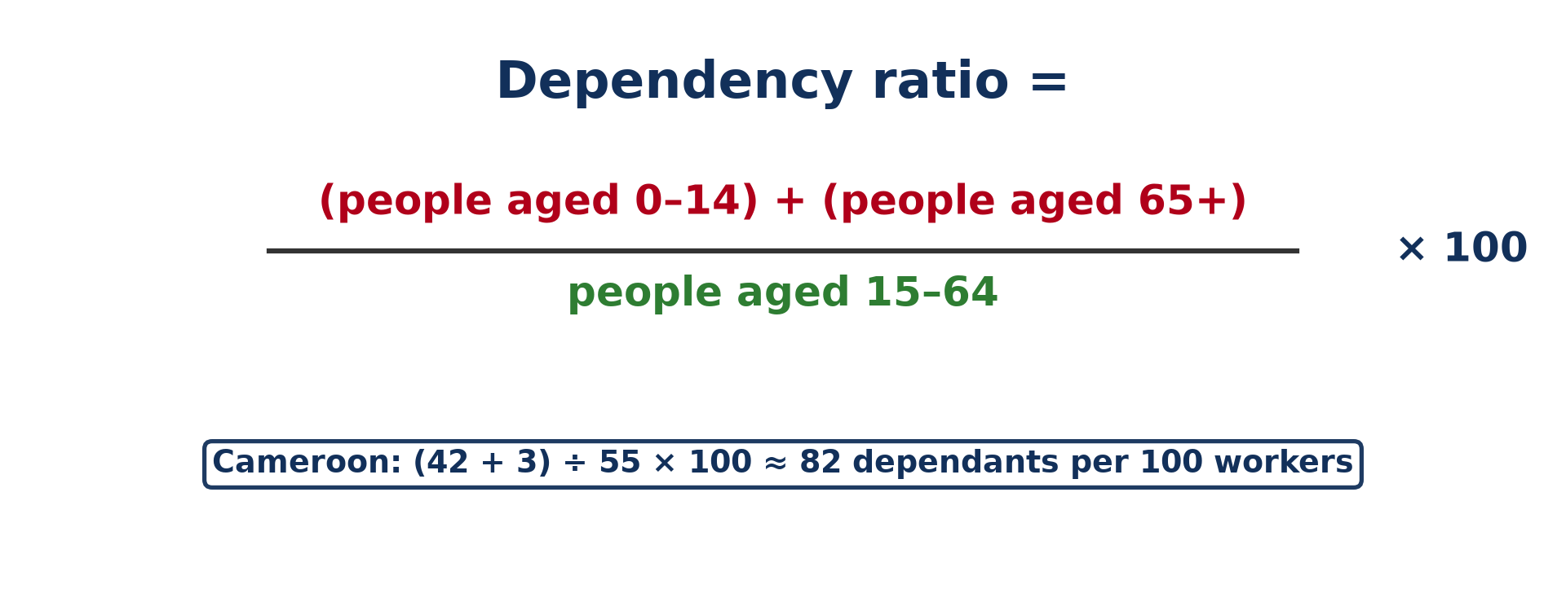
4. DEPENDENCY
Activity 5
The dependency ratio.
Notes:
Activity 5. Look carefully at this diagram: the dependency ratio. Observe every detail before I ask the question.

Slide 33
4. DEPENDENCY
Activity 5: Question
Calculate the dependency ratio: 6,000 children, 2,000 elderly and 10,000 adults.
Notes:
Here is the question for Activity 5: Calculate the dependency ratio: 6,000 children, 2,000 elderly and 10,000 adults. Take one minute to think and write your answer in your rough notebook.

Slide 34
4. DEPENDENCY
Activity 5: Answer
(6,000 + 2,000) ÷ 10,000 × 100 = 80 %.
Notes:
Let us check the answer together. (6,000 + 2,000) ÷ 10,000 × 100 = 80 %.

Slide 35
BOARD SUMMARY
Board Summary
Topic: Population Structure and Composition
Sub-topic: Age-Sex Pyramids
Lesson 7: Population Pyramids
Notes:
Now we are going to copy the board summary. Write the title and the headings neatly in your notebooks. I will give you enough time for each slide, so do not rush.

Slide 36
BOARD SUMMARY
DEFINITIONS
The key terms of this lesson are defined as follows:
Population pyramid: It is a double bar graph showing the age and sex composition of a population at a given time.
Age cohort: It is a group of people born in the same period, usually five years.
Notes:
Let us copy the definitions. The key terms of this lesson are defined as follows. On this slide we have Population pyramid and Age cohort. Write each point on a new line, with the key term first, and explain it in your own words when we revise. When you finish, we go to the next slide.

Slide 37
BOARD SUMMARY
DEFINITIONS (continued)
Base: It is the bottom of the pyramid, showing the youngest people and the birth rate.
Apex: It is the top of the pyramid, showing old people and life expectancy.
Notes:
We continue with the definitions. On this slide we have Base and Apex. Write each point on a new line, with the key term first, and explain it in your own words when we revise. When you finish, we go to the next slide.

Slide 38
BOARD SUMMARY
DEFINITIONS (continued)
Dependency ratio: It is the number of dependants (0 to 14 and 65+) for every 100 people aged 15 to 64.
Notes:
We continue with the definitions. On this slide we have Dependency ratio. Write each point on a new line, with the key term first, and explain it in your own words when we revise.

Slide 39
BOARD SUMMARY
1. Meaning and Types of Population Pyramids
A) Structure
A population pyramid is built as follows:
Vertical axis: It shows the age groups, usually in five-year cohorts (0 to 4, 5 to 9, 10 to 14, and so on up to 80+). The youngest are at the bottom and the oldest at the top.
Illustration: the parts of a pyramid
Notes:
Let us copy Structure. A population pyramid is built as follows. Copy the point on Vertical axis on the left, then draw the diagram on the right: the parts of a pyramid. Give it a title and label it clearly.

Slide 40
BOARD SUMMARY
1. Meaning and Types of Population Pyramids
A) Structure
Horizontal axis and arrangement: It shows the percentage or the number of people in each group. Males are always on the left and females on the right.
Notes:
We continue with Structure. Copy the point on Horizontal axis and arrangement: write the key term first, then its explanation.

Slide 41
BOARD SUMMARY
1. Meaning and Types of Population Pyramids
A) Structure
Base and apex: The base shows births and children, so a wide base means a high birth rate. The apex shows old people, so a wide apex means a long life expectancy.
Notes:
We continue with Structure. Copy the point on Base and apex: write the key term first, then its explanation.

Slide 42
BOARD SUMMARY
1. Meaning and Types of Population Pyramids
B) Types
There are four types of population pyramids:
Progressive (expanding) pyramid: It has a broad base and a narrow top, showing high birth rates and short lives. It is found in Nigeria, Cameroon and most developing countries.
Illustration: the four types of pyramids
Notes:
Let us copy Types. There are four types of population pyramids. Copy the point on Progressive (expanding) pyramid on the left, then draw the diagram on the right: the four types of pyramids. Give it a title and label it clearly.

Slide 43

BOARD SUMMARY
1. Meaning and Types of Population Pyramids
B) Types
Regressive (contracting) pyramid: It has a narrow base and a wide middle and top, showing low birth rates and an ageing population. It is found in Japan and Germany.
Illustration: the pyramid of Japan
Notes:
Copy the point on Regressive (contracting) pyramid on the left, then draw the diagram on the right: the pyramid of Japan. Give it a title and label it clearly.

Slide 44
BOARD SUMMARY
1. Meaning and Types of Population Pyramids
B) Types
Stationary pyramid: It has nearly equal bars up to old age, showing low birth and death rates and slow growth. It is found in Sweden and the USA.
Notes:
We continue with Types. Copy the point on Stationary pyramid: write the key term first, then its explanation.

Slide 45
BOARD SUMMARY
1. Meaning and Types of Population Pyramids
B) Types
Composite pyramid: It combines features of both, with a narrowing base above a wider middle. It shows a population in transition with falling births, as in Brazil and Mexico.
Notes:
We continue with Types. Copy the point on Composite pyramid: write the key term first, then its explanation.

Slide 46
BOARD SUMMARY
2. Differences between Parts of the World
Population pyramids differ between the following parts of the world:
Developing countries: Sub-Saharan Africa has broad-based pyramids, with high birth rates, high child mortality and rapid growth. Few people reach old age.
Illustration: the pyramid of Cameroon
Notes:
Let us copy Differences between Parts of the World. Population pyramids differ between the following parts of the world. Copy the point on Developing countries on the left, then draw the diagram on the right: the pyramid of Cameroon. Give it a title and label it clearly.

Slide 47
BOARD SUMMARY
2. Differences between Parts of the World
Developed countries: Europe, North America and Japan have narrow bases and wide tops. Their fertility is low and their populations are ageing.
Notes:
We continue with Differences between Parts of the World. Copy the point on Developed countries: write the key term first, then its explanation.

Slide 48
BOARD SUMMARY
2. Differences between Parts of the World
Emerging countries: India and Brazil have composite pyramids because their births are falling and life expectancy is rising. Their pyramids are becoming more rectangular.
Notes:
We continue with Differences between Parts of the World. Copy the point on Emerging countries: write the key term first, then its explanation.

Slide 49
BOARD SUMMARY
3. Factors of the Shape of Pyramids
A) Demographic Factors
The shape of pyramids is influenced by the following demographic factors:
Falling births: Declining birth rates narrow the base of the pyramid in the long run. The pyramid becomes top-heavy, as in industrial countries.
Notes:
Let us copy Demographic Factors. The shape of pyramids is influenced by the following demographic factors. Copy the point on Falling births: write the key term first, then its explanation.

Slide 50
BOARD SUMMARY
3. Factors of the Shape of Pyramids
A) Demographic Factors
High births and falling deaths: High birth rates with falling death rates give a broad base and a young population. The pyramid widens at the bottom.
Notes:
We continue with Demographic Factors. Copy the point on High births and falling deaths: write the key term first, then its explanation.

Slide 51
BOARD SUMMARY
3. Factors of the Shape of Pyramids
A) Demographic Factors
In-migration: The arrival of adult workers, often men, creates a bulge in the working ages. This is seen in the Gulf countries and in big towns.
Notes:
We continue with Demographic Factors. Copy the point on In-migration: write the key term first, then its explanation.

Slide 52

BOARD SUMMARY
3. Factors of the Shape of Pyramids
A) Demographic Factors
Out-migration: The departure of young adults creates a notch in the working ages. This is seen in the rural villages of Cameroon.
Illustration: migrants at a bus station
Notes:
Copy the point on Out-migration on the left, then draw the diagram on the right: migrants at a bus station. Give it a title and label it clearly.

Slide 53
BOARD SUMMARY
3. Factors of the Shape of Pyramids
B) Non-Demographic Factors
The shape of pyramids is also influenced by the following non-demographic factors:
War: War kills many adult men and reduces births in the short run, creating notches in the pyramid. A baby boom may follow when peace returns.
Illustration: refugees
Notes:
Let us copy Non-Demographic Factors. The shape of pyramids is also influenced by the following non-demographic factors. Copy the point on War on the left, then draw the diagram on the right: refugees. Give it a title and label it clearly.

Slide 54

BOARD SUMMARY
3. Factors of the Shape of Pyramids
B) Non-Demographic Factors
Improved medical services: Vaccination and better health care lower death rates at all ages. In the long run, the pyramid becomes more rectangular.
Illustration: vaccination
Notes:
Copy the point on Improved medical services on the left, then draw the diagram on the right: vaccination. Give it a title and label it clearly.

Slide 55
BOARD SUMMARY
3. Factors of the Shape of Pyramids
B) Non-Demographic Factors
Epidemics and disasters: Diseases such as HIV/AIDS reduce some age groups, especially young adults. Earthquakes, floods and famines reduce the population of the groups affected.
Notes:
We continue with Non-Demographic Factors. Copy the point on Epidemics and disasters: write the key term first, then its explanation.

Slide 56
BOARD SUMMARY
3. Factors of the Shape of Pyramids
B) Non-Demographic Factors
Marriage customs: Early marriage and the value placed on large families broaden the base. Late marriage and small families narrow it.
Notes:
We continue with Non-Demographic Factors. Copy the point on Marriage customs: write the key term first, then its explanation.

Slide 57
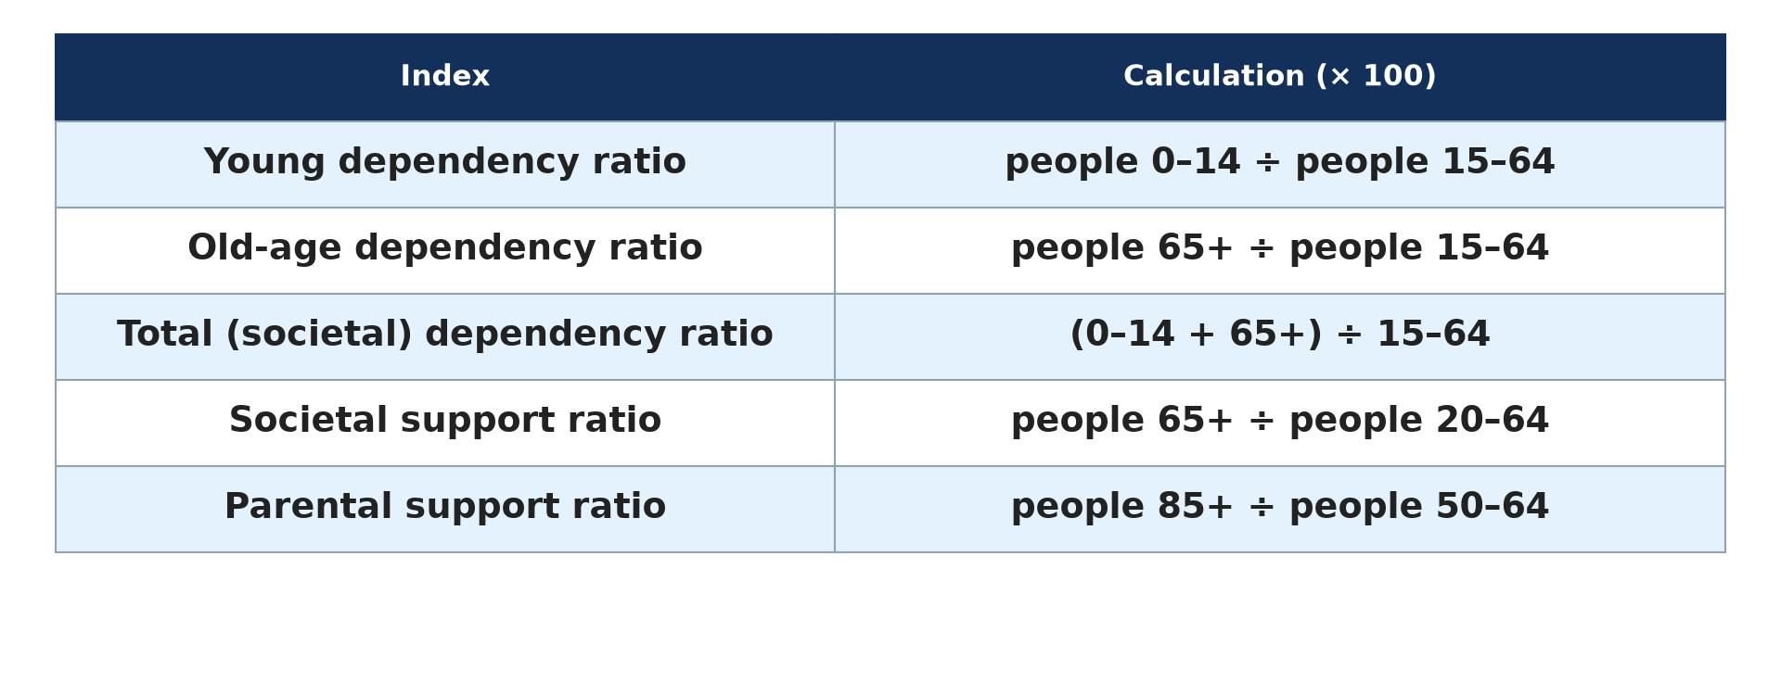
BOARD SUMMARY
4. Indices of Population Structure
The structure of a population is measured with the following indices:
Young dependency ratio: It is calculated as people aged 0 to 14 ÷ people aged 15 to 64 × 100. It is very high in developing countries.
Illustration: dependency indices
Notes:
Let us copy Indices of Population Structure. The structure of a population is measured with the following indices. Copy the point on Young dependency ratio on the left, then draw the diagram on the right: dependency indices. Give it a title and label it clearly.

Slide 58
BOARD SUMMARY
4. Indices of Population Structure
Old-age dependency ratio: It is calculated as people aged 65+ ÷ people aged 15 to 64 × 100. It is very high in ageing countries such as Japan.
Notes:
We continue with Indices of Population Structure. Copy the point on Old-age dependency ratio: write the key term first, then its explanation.

Slide 59
BOARD SUMMARY
4. Indices of Population Structure
Total dependency ratio: It is calculated as (people aged 0 to 14 + people aged 65+) ÷ people aged 15 to 64 × 100. It shows the total burden on the working population.
Illustration: the dependency ratio
Notes:
Copy the point on Total dependency ratio on the left, then draw the diagram on the right: the dependency ratio. Give it a title and label it clearly.

Slide 60
BOARD SUMMARY
4. Indices of Population Structure
Support ratios: The societal support ratio is people aged 65+ ÷ people aged 20 to 64, and the parental support ratio is people aged 85+ ÷ people aged 50 to 64. They show how many old people each worker or adult child must support.
Notes:
We continue with Indices of Population Structure. Copy the point on Support ratios: write the key term first, then its explanation.

Slide 61
FORMATIVE EVALUATION
Evaluation 1
Describe a regressive pyramid and give one example.
Notes:
Now let us check what you have understood. Question 1: Describe a regressive pyramid and give one example. Answer in your exercise book.

Slide 62
FORMATIVE EVALUATION
Expected Answer
It has a narrow base and a wide top, showing low births and many old people, e.g. Japan.
Notes:
The expected answer is: it has a narrow base and a wide top, showing low births and many old people, e.g. Japan. If you got it right, well done.

Slide 63
FORMATIVE EVALUATION
Evaluation 2
Calculate the dependency ratio of a region with 5,000 children, 1,000 elderly and 4,000 adults.
Notes:
Now let us check what you have understood. Question 2: Calculate the dependency ratio of a region with 5,000 children, 1,000 elderly and 4,000 adults. Answer in your exercise book.

Slide 64
FORMATIVE EVALUATION
Expected Answer
(5,000 + 1,000) ÷ 4,000 × 100 = 150 %.
Notes:
The expected answer is: (5,000 + 1,000) ÷ 4,000 × 100 = 150 %. If you got it right, well done.

Slide 65
REMEDIATION
Remediation
Fill in the blanks:
On a pyramid, males are on the ______.
A broad base shows a high ______ rate.
The pyramid of Japan is ______.
Notes:
For those who need more practice, fill in the blanks in your exercise book. The answers are: number 1, left; number 2, birth; number 3, regressive.

Slide 66
HOMEWORK
Homework
Write the formula of the dependency ratio.
Notes:
For your homework: Write the formula of the dependency ratio. We shall correct it at the beginning of our next lesson.

Slide 67
NEXT LESSON
Next Lesson
Our next lesson will be on:
Practical Work 3: Dependency Ratio and Population Pyramids
Notes:
Our next lesson will be on Practical Work 3: Dependency Ratio and Population Pyramids. Thank you for your attention, and see you next time.

Slide 68
BILINGUAL GAME
Bilingual Game (Jeu Bilingue)
English | Français
Population pyramid | La pyramide des âges
Birth rate | Le taux de natalité
Life expectancy | L'espérance de vie
Dependency ratio | Le taux de dépendance
Age cohort | La cohorte d'âge
Ageing population | La population vieillissante
Notes:
Let us play the bilingual game. I say a word in English, and you give me the French word. Then we do the reverse.

Slide 69
LOGBOOK
Official Logbook (1/2)
Module / Topic | Population Structure and Composition
Lesson Title | Lesson 7: Population Pyramids
Expected Learning Outcomes | Define a population pyramid and describe its structure. Describe the four types of population pyramids. Compare the pyramids of developing, developed and emerging countries. Explain the demographic and non-demographic factors of their shape. Name the indices of dependency.
Competence | Learners are able to read and interpret population pyramids and explain the factors of their shapes.
Notes:
I record this information in the official logbook of the class after the lesson.

Slide 70
LOGBOOK
Official Logbook (2/2)
Matter Taught | DEFINITIONS; Structure; Types; Differences between Parts of the World; Demographic Factors; Non-Demographic Factors; Indices of Population Structure.
Evaluation | Formative evaluation and remediation exercise.
Homework | Write the formula of the dependency ratio.
Enrolment / Present / Absent | ____ / ____ / ____
Achievement | To be completed after the lesson.
Notes:
I complete the second page of the logbook: the matter taught, the evaluation, the homework and the attendance.

Slide 71
TEACHER'S NOTE
Teacher's Note
Timing: Homework correction, plan, objectives 8 min | Recall, situation, action 10 min | 5 activities 30 min | Board summary (copying) 30 min | Evaluation, remediation 10 min | Homework, next lesson 5 min | Logbook 7 min
Without the projector (Activity 1): draw the axes of a pyramid.
Without the projector (Activity 2): draw the four shapes.
Without the projector (Activity 3): describe the pyramid of Cameroon.
Without the projector (Activity 4): draw a notch on a pyramid.
Without the projector (Activity 5): do the calculation on the board.
Notes:
This slide is for me, the teacher: it gives the timing of the lesson and what to do if the projector is not available.

Slide 72
REFERENCES
References
Geography Syllabus for Sixth Forms (Lower and Upper Sixth), MINESEC, 2019 — Module 4 (Population Geography).
Teacher's course notes: Mr KAMDEM E., Population Geography (USA), GBHS Garoua, 2026.
United Nations, World Population Prospects 2024.
Photo, Activity 4: “Secretary-General Visits Refugee Camps in Chad” by United Nations Photo, CC BY-NC-ND 2.0, via Flickr (https://www.flickr.com/photos/35483578@N03/6140060599)
Photo, board summary (Out-migration): “Wadi Halfa Bus Station” by D-Stanley, CC BY 2.0, via Flickr (https://www.flickr.com/photos/79721788@N00/8651154444)
Photo, board summary (Improved medical services): “Isatu gets a vaccination for her 5 week old son” by World Bank Photo Collection, CC BY-NC-ND 2.0, via Flickr (https://www.flickr.com/photos/10816734@N03/26372818523)
Diagrams and animations: drawn for this lesson (Geography Department).
Notes:
These are the references and picture credits used to prepare this lesson.

